Slide 1
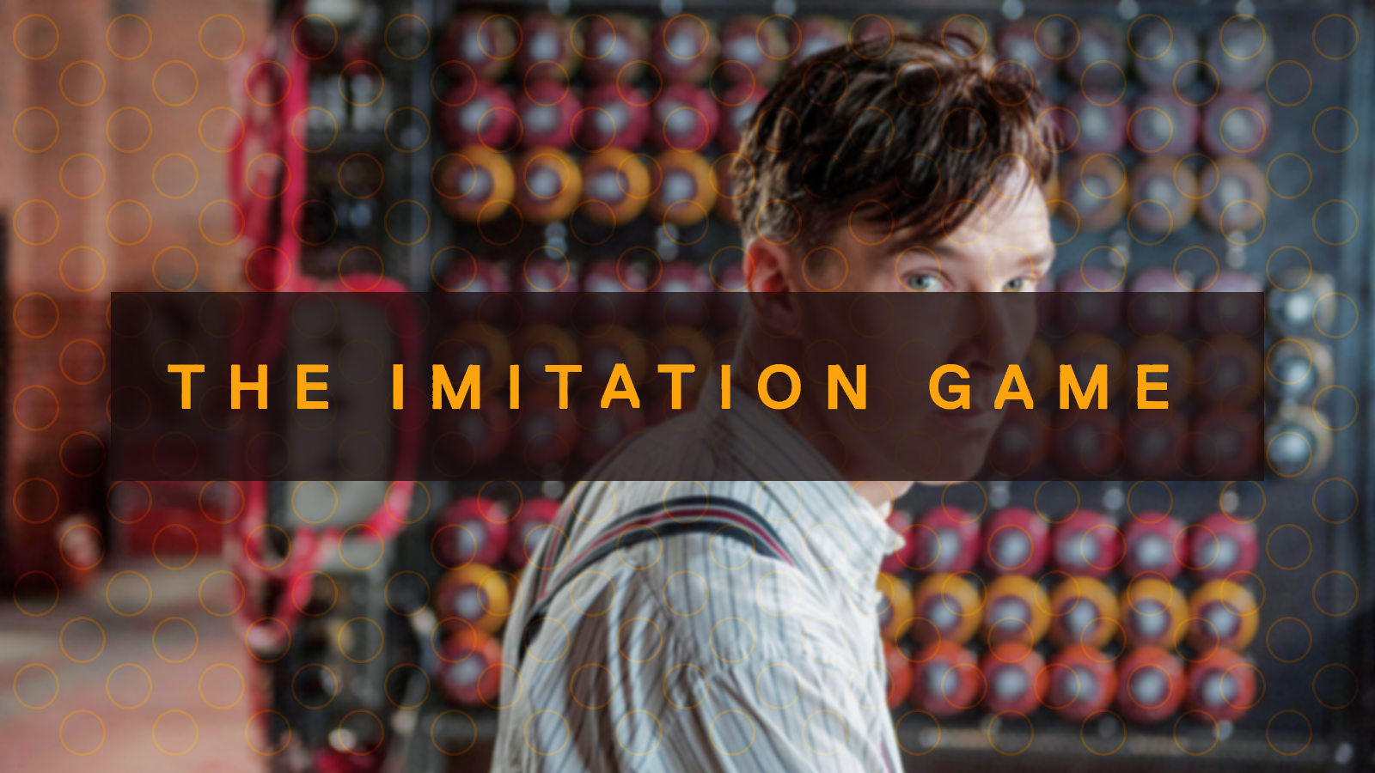
Programming Challenge #5

Slide 2

Some Background
Caesar cipher
One of the simplest types of cipher, it involves shifting the letters n-letters to the right
With a shift (n) of 2 a-> c, b -> d, c -> e
If we know the most common letters in English we can guess what the shift is (or we can brute force it)
In order: e, t, a
Or if we look for patterns for example: ‘the’, ‘to’ etc..

Slide 3
The challenge
Get into groups of 2. You and your partner must develop an algorithm to encrypt a phrase on the next slide.
Rules:
You must be able to write down the algorithm in a series of steps anyone can follow.
It must be simple within reason
The algorithm must be decryptable by the receiver (using similar steps).
Swap partners and try to decrypt each others cipher.
Prizes go to the person whose cipher does not get decrypted, but can be.

Slide 4
The Challenge
You and your partner are now German generals in World War 2
One of you is on the western front against the UK, France, the USA etc..
And the other is on the eastern front against The USSR
You need to send messages between the fronts but you both know that the enemies are listening in.
You decide to encrypt your messages and meet in Berlin to discuss how to do so.
You decide that your encryption must be:
Easy for the other person to solve so if there is a push on either side you know quickly.
A series of simple steps so you can give the method to another general in Northern Africa (who’s a bit thick and needs clear simple steps).
Be difficult to decrypt so the allies cannot easily solve it and listen in.

Slide 5
Phrases to Encrypt
Choose one of these famous phrases to encrypt and then choose another sentence (not on the list) to also send using the same algorithm.
“Never in the field of human conflict, has so much, been owed by so many, to so few!”
“Defend Paris to the last, destroy all bridges over the Seine and devastate the city.”
“The fate of the Empire rests on this enterprise every man must devote himself totally to the task in hand.”
“The Red Army and Navy and the whole Soviet people must fight for every inch of Soviet soil, fight to the last drop of blood for our towns and villages...onward, to victory!”
“On the European Front, the most important development of the past year has been the crushing German offensive against the great armies of Russia”

Slide 6
The Challenge - Part 2
You spend a few months using the cipher and eventually decide to start intercepting messages, you meet your partner in Berlin again and discuss the messages you have intercepted.
You read the news and have a good idea of what is going on in the war and so know that the message must be one of the messages on the previous slide.
Try and decrypt the intercepted message together and work out the algorithm, test your algorithm by using an unknown ciphertext and see if you can decrypt it.
If your cipher is not able to be decrypted, you will be able to earn prizes from the Nazi state.

